Slide 1


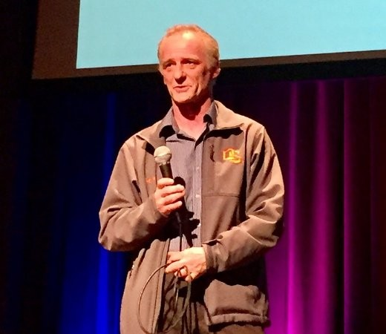
Full-In Production
Andrew Ferlitsch
Google Cloud AI / Developer Relations
@andrewferlitsch
Code, Notebooks: https://github.com/GoogleCloudPlatform/keras-idiomatic-programmer

Slide 2
Timeline
01

Slide 3

Timeline
2017
2018
2019
2020
Planning /
Discovery
Exploration /
Prototyping
Development / Transition
Production
Full Production
10K Data Scientists
250K Data Scientists
2M ML practitioners
Decision Makers
Eng Staff
ML Consultants
Sr. Eng Mgr
Sr. Data Scientist Lead Data Engineer DB Team ML Consultants
CTO Sr. Data Scientist Lead Jr. Data Scientists
Data Engineers(s) ML Ops ML API Services ISVs
CTO / COO / Executive(s) Sr. Data Scientist Lead Jr. Data Scientists
Data Engineers(s) ML Ops ML/AI managed services
ML/AI Turnkey solutions ISVs
AI/ML on everyone’s radar
Peak of Gartner’s Hypecurve
Everyone is full in

Slide 4
Timeline
2017
2018
2019
2020
Planning /
Discovery
Exploration /
Prototyping
Development / Transition
Production
Full Production
Business Intelligence + ML Scilearn, NLTK
CART Analysis
Statistics Background
Deep Learning Tensorflow / Pytorch
Transfer Learning ML APIs ML managed training services
Stats / CS / Data backgrounds
Deep Learning / RL Meta-Learning Builtin ML Algorithms
Hyperparameter Search
Macro-Architecture Search ML/AI managed e2e services ML/AI turnkey solutions
CS / AI / Data / Ops backgrounds
Data Validation
Meta-Learning Explosion ??

Slide 5











2019 Production Flow
Data Repo
Data Labelling
Validation
Data Distribution
Model Training
Versioning
Deploy
A/B Testing
Trained Model Repo
Model Instances
Warmup Instances

Slide 6
It’s Not Just a Model Anymore!
02

Slide 7
Model vs. Application
We don’t talk anymore about a “single model”, or a collection of independent models.
We now build applications as composition (amalgamation) of models and AI services (APIs, Turnkey solutions).
Models are becoming more:
Multi-Task
Self (Meta) Learning
Common Layers
Connecting via Embeddings

Slide 8
Macro Architecture for Classifier
Image Data
Macro-Architecture (e.g., CNN)
Embedding (final feature maps flatten after bottleneck layer)
Learner
Conv Group
Conv Group
Conv
Group
Stem
Classifier
Pre-Stem Group
Stem Convolution Group
...
Classifier Group
Learned Feature Maps
Transfer Learning uses existing embeddings and retrains a new classifier.

Slide 9
Example: Multi-Task Model (OD)
Faster R-CNN Macro-Architecture
Pretrained Convolutional Neural Network (Reuse)
Conv
Net
Region
Proposal
Network
(RPN)
Region of Interest (RoI) Pooling
Classifier
Stem Convolution Group
Two models are learned in parallel using shared layers
Bounding Box Regresser
Shared Feature Maps
Location (Bounding Box) Learning
‹#›
Feature & Classification Learning

Slide 10
Example: Home Vision Analysis
Interior
MultiClass
Classifier
Market Appeal
Demographic
Binary Classifier
Regressor
Valuation
Sell, Rent
Regressor
Renovation
Repairs
Exterior

Slide 11
Example: Home Vision Analysis
MultiClass Classifier
Condition
Two-Tier: Coarse (e.g. room type)
Detail (e.g., items in room)
Embedding Crops
Object
Detection
Amenities
MultiClass
Classifier
Market Appeal
Dense Embeddings
Embedding
MultiClass Classifier
Regressor
Condition
Valuation

Slide 12
Example: Sports Broadcasting
What is in the frame
Who(m) is(are) the player(s)
Face Recognition (Player)
Pose Estimation
Shared Conv Net
Object Detection
Live Video
Object Level Embeddings
Market Specific
Language
Dense Embedding
What is happening
Predictive Action (non-RNN)
Image Captioning
Translation (Market)
Text-to-Speech
Closed Caption

Slide 13

Example: Power Transmission Lines
Video Stream
Object
Detection
MultiClass Classifier
Condition
(Auto) Labeled Data
Line Impedance Sensors
Anomaly
Detection
Maintenance

Slide 14
Developments in Commercial AutoML
03

Slide 15
AutoML Today
AutoML has came along ways since Google’s paper on Nasnet
Levels of Service.
Transfer Learning (Builtin Algorithms)
Hyperparameter Search
Macro-Architecture Search (MobileNet V3)
Micro-Architecture Search (NasNet, EfficientNet)
[Research] Data Validation
* not covered

Slide 16
Builtin Algorithms - Transfer Learning
Pre-Built Model Architecture
Stem Convolutional Group
Preset Input Shape (e.g., (224, 224, 3))
Conv Group(s)
Final Pooling Flatten Layer
Classifier (Dense) Layer
Preset Classifier (e.g., 1000 classes)
Convolutions
Model Architecture Specific Convolutional Groups
Final layer before classifier, also called the Bottleneck Layer (Embedding)

Slide 17
Builtin Algorithms - Transfer Learning
Reconfigurable Pre-Built Model Architecture
Stem Convolutional Group
Input Shape (e.g., (None, None, 3))
Conv Group(s)
Final Pooling Flatten Layer
Optional (pooling=None) If not included, then the activation layer for the final convolution is the bottleneck layer.
Convolutions
No Classifier
Model Architecture Specific Convolutional Groups
Final layer before classifier, also called the Bottleneck Layer (Embedding)

Slide 18



Hyperparameter Search
The Big Three
Learning Rate (Scheduler)
Batch Size
Regularization

Slide 19
Hyperparameter Search
Learning Rate Scheduler
Warmup weight initialization using very small learning rate on ensemble of models.
Select model instance with best numerical stability (lottery principle).
Learn the optimal learning rate schedule
Model instance with the selected weight initialization.
Model instance with the selected weight initialization.
Full training with the learned learning rate schedule.
Warmup
Pre-Training
Model Training
Model Instances
Model Instances
Model Instances
Model Training
Model Training
Model Training

Slide 20
Hyperparameter Search
Batch Size
Progressively increase batch size later in training adds numerical stability for convergence.
Large batch sizes act as smoothing factor (an implicit form of regularization), resulting in less need of regularization.
Dynamic change in model regularization requires dynamic graph.
Training
Progressively decrease model regularization as batch size increases.

Slide 21
Hyperparameter Search
Regularization
Value learned during pre-training.
Conv Group
Conv Group
Conv
Group
Dropout
Label Smoothing
Stem Convolution Group
...
Classifier Group
Noise
Initial value learned during pre-training.
Stepwise reduced as batch size increases.
Layer Regularization, Batch Normalization

Slide 22
Hyperparameter Search
Macro-Architecture Search
Meta-Parameters - These are the parameters for configuring macro-architecture.
Hyper-parameters - These are the parameters for training the model.
Parameters - These are the parameters the model will learn during training.

Slide 23
Hyperparameter Search
Macro-Architecture Search
Metaparameters: Number of convolutional groups (depth), number of output filters (width), and type of convolutional group (e.g., resnet v2).
Conv Group
Type
Conv Group
Type
Conv
Group
Type
...
Learner

Slide 24
Hyperparameter Search
Macro-Architecture Search
class MyModel():
def init(self, input_shape, n_classes, **metaparameters):
inputs = Input(shape=input_shape)
layers = stem(inputs)
layers = learner(layers, metaparameters)
outputs = classifier(layers, n_classes)
model = Model(inputs, outputs)
def stem(self, inputs):
...
def learner(self, inputs, **metaparameters):
...
def classifier(self, inputs, n_classes):
...
Composable Design Pattern of coding an AutoML friendly model in TF.Keras.
I.e., bring your own model to AutoML.

Slide 25
Hyperparameter Search
Macro-Architecture Search
Metaparameters: Number of blocks (depth), type of block (e.g., resnet v2), squeeze/expansion factor, layer regularization.
Conv Block
Type
Conv Block
Type
Conv
Block
Type
...
Convolutional Group

Slide 26
Hyperparameter Search
class MyModel():
metaparameters = {
‘groups’ :[ { n_blocks: 4, filters: 32 }, {n_blocks: 8, filters:64} ] }
def learner(self, inputs, **metaparameters):
...
for group_params in metaparameters[‘groups’]:
inputs = group(inputs, group_parameters)
@staticmethod
def group(inputs, **metaparameters):
for block_params in metaparameters[‘n_blocks’]:
inputs = block(inputs, block_parameters)
@staticmethod def block(inputs, **metaparameters):
...
Composable Design Pattern of coding an AutoML friendly model in TF.Keras.
@staticmethod provides means to tear off buildable micro components that are configured by metaparameters (factory design pattern).
‹#›

Slide 27

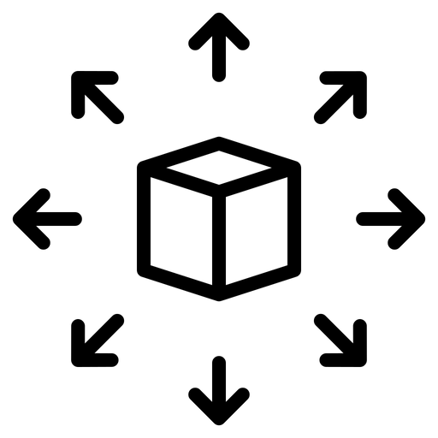

Data Validation
Automatic Data Validation / Learned Valuation
Schema
Training and Serving Distributions
Data Valuation Reinforcement Learning
‹#›

Slide 28

Schema
Test
(Holdout) Data
Profiler
Schema
Automatically generated schema
The test data (or randomly selected sampling distribution) is processed automatically to determine characteristics and feature distributions.
Data Engineers fine-tune and add preprocessing and feature engineering rules.
‹#›

Slide 29
Schema
Schema
Examples are preprocessed and feature engineered automatically.
Other tasks may include rebalancing, resampling (boosting).
Flags or deletes out of distribution examples.
Model Training
Training Data
Validator
Preprocessor
Mini
Batches
Data Engineers review flagged or deleted examples.
‹#›

Slide 30
Training and Serving Distributions
Distribution Skew
Model Evaluation
Deployed Model
The deployed model maintains a running distribution of predictions from real-world usage.
The distribution of predictions from test (holdout) data becomes part of the model’s metadata (e.g., model card)
Model Metadata
Prediction
Distribution
Schema
Prediction
Distribution
The model’s test and usage prediction distributions are compared for substantial difference in balance (skew)
‹#›

Slide 31
DV Reinforcement Learning
Data Valuation
Use reinforcement learning on dataset to detect:
Noisy data
Corrupt data
Low vs. High value data
Train model on only high value data.
‹#›

Slide 32
DV Reinforcement Learning
Data Valuation
Train two models in parallel using the training data.
Data Value Estimator
Predictor Model
Training Data
Weighted
Values Loss
Selector
Predictions Loss
Select subset of examples based on weighted value.
Reinforcement Learning
Random initialization of weight values (label) per example.
Calculate reward to update weighted value (label) of examples.
‹#›

Slide 33
Data Engineering
04

Slide 34
Data Transformation
Data
Raw (‘source’) data
MSD
Preprocessed Data (model specific)
M2MD
Embeddings (model to model)

Slide 35
Moving Preprocessing into Graph
Implement preprocessing as graph operations (e.g., AutoGraph) in plug-n-play pre-stem modules:
Crop / Padding
Resizing
Normalization
Can use tf.keras Functional API to extend existing model to add data preprocessing pipeline to existing model
Model
Stem
Pre-Stem Group
Stem Convolution Group
Converting “Raw Data” into “Machine Learning Ready Data” inside the model.

Slide 36
Translational Invariance
Image Augmentation
Input
Feature
Maps
Concat
Convolutions
Identity Link with translational invariance steps
Image Augmentation for translational invariance moving into the graph.
Random Crop
Upsampling
Random Flip
Random Rotate

Slide 37
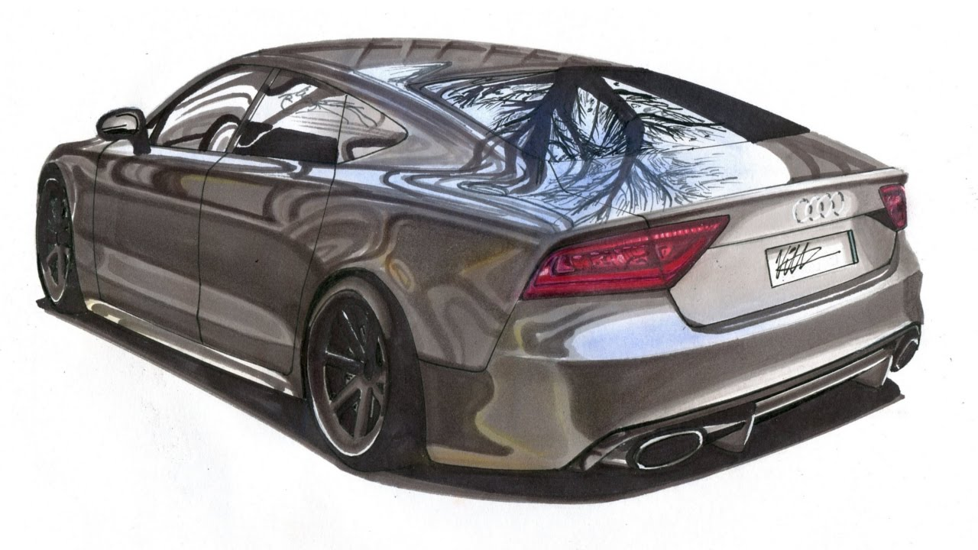

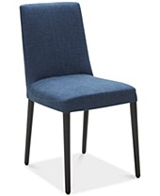
Learning Essential Features
We stopped learning data -- we now learn “essential features”
Synthetic Data (prebuilt datasets or generators, i.e., Unity)
Occlusion (overlaying objects on “item being classified”)
Optical Flow (overlaying objects in the background, i.,e., Flying Chairs)

Slide 38

Learning Essential Features
Pre-train with Synthetic Data
Synthetic Data
Model Training
Embedding
Learn embedding for essential features.
Pre-training
Real-World Data
Full-Training
Fine-Tuning

Slide 39
Learning Essential Features
Train with Occlusion
Overlay natural objects for scene that obscures part of the object being recognized.
Occlusion Objects
Model Training
Embedding
Learn embedding for essential features.
Real-World Data
Full-Training

Slide 40
Learning Essential Features
Train with Optical Flow
Overlay non-natural objects for scene in the background.
Optical Objects
Model Training
Embedding
Aids in filtering background features.
Real-World Data
Full-Training

Slide 41
Bias
(SME) Identify which classes are demographically imbalanced.
Resampling rules are added to adjust for imbalance.
Imbalanced Dataset
Model Training
Resampling
Mini
Batches
Examples from imbalanced classes may appear more than once per epoch (boosting)
Bias is caused when the dataset is imbalanced to the “real-world” population that the model will see when deployed.

Slide 42
Fairness
(SME) Identify which features have culturally discrimination.
Add rules for generating synthetic examples from existing examples by reducing collinearity between discriminating features.
Removing cultural features (gender, race, age, …) does not work due to the fact that other features have collinearity with them (they predict each other).
Example: Where gender and income features would be discriminatory. Generate new examples by randomly flipping the gender.
Discriminatory Dataset
Non-Discriminatory Dataset
Synthetic Generator
Non-Fairness is caused when prior cultural discrimination is represented in the dataset.

Slide 43
Meta-Learning
05

Slide 44

Meta-Learning
Knowledge Distillation
(un) Labeled Data
Semi-Supervised Learning
(un) Labeled Data
Weakly-Supervised Learning

Slide 45
Knowledge Distillation
Use Large Models to Train Compact (e.g., Mobile) Models
Pre-trained Large Model (Teacher)
Softmax
Class probability distribution (soft labels).
The loss between the teacher’s soft labels and student, along with hard labels, is backward propagated.
Training Data
Loss Function
Compact Model (Student)
Softmax
Predictive probability distribution
Compact Model being Trained to Mimic Large Model

Slide 46
Semi-Supervised Learning
Model trained on Label Data
The Pseudo Labeled data and Labeled data are merged into new training set.
Unlabeled Data
Pseudo labeled Data
Composite
Training Data
Labeled Data
Model has good accuracy to start with.

Slide 47
Semi-Supervised Learning
Composite
Training Data
Next Composite
Training Data
Continued Training of Model
After each epoch, the refined pseudo labeled data is recombined with label data for a new (better) composite training set.
Pseudo labeled Data
Mini-batches are drawn with mix of labeled and pseudo labeled data.
Batches smooth out the error, and the error acts as a regularizer.
Labeled Data
Continuously repeat. The next composite training set is feed for training.

Slide 48
Weakly-Supervised Learning
Ensemble in Training
Noisy Data
1) An ensemble set of models are trained on noisy labeled data.
Weak Learner
Source is generally from crowd sourced data.
Weak Learner
Labeled Data
2) The ensemble set of models is fine-tuned on good label data.
Good Label data.
Weak Learner

Slide 49
Weakly-Supervised Learning
The weakly trained ensemble is used to generate “less noisy” labels.
Weakly Trained Ensemble
Train a strong model with combined good label data and less noisy labeled data.
Weak Learner
Noisy Data
Less Noisy Data
Weak Learner
Strong Model
Weak Learner
The noisy data is feed thru the ensemble in predictive mode.
Labeled Data

Slide 50
Postface
06

Slide 51
CV and NLP Convergence
NLP and CV Model Designs appear to be Converging
Rise of the “Transformers”
NLP
CV
“Embeddings”
Moving away from RNN (e.g. LSTM) to spatial models (e.g., Attention is all you need).
Learn embeddings for images, which are used to train other models.

Slide 52
Explainable AI
Society won’t trust Models whose predictions can’t be explained, audited and justified.
Heat Map
Black Box Model
Instrumented Model
Instrument
Embed instrumentation into the model layers (profiling.
Make Prediction
How strong did each feature contribute to the prediction.

Slide 53
Explainable AI
Heat Map
If a person’s income was X more, it would have flipped the decision.
Instrumented Model
If a person’s credit score was Y more, it would have flipped the decision.
Make Prediction
Detect data points in features that where near edge of linear separation.

Slide 54
(2020) Job Definitions
Innovation Centers
Production
Machine Learning
Operations
Applied Data Scientists (Senior)
Research Data Scientists
AI Application Engineers
Machine Learning Engineers
Data Engineers
QA
Not well defined how QA fits in.

Slide 55

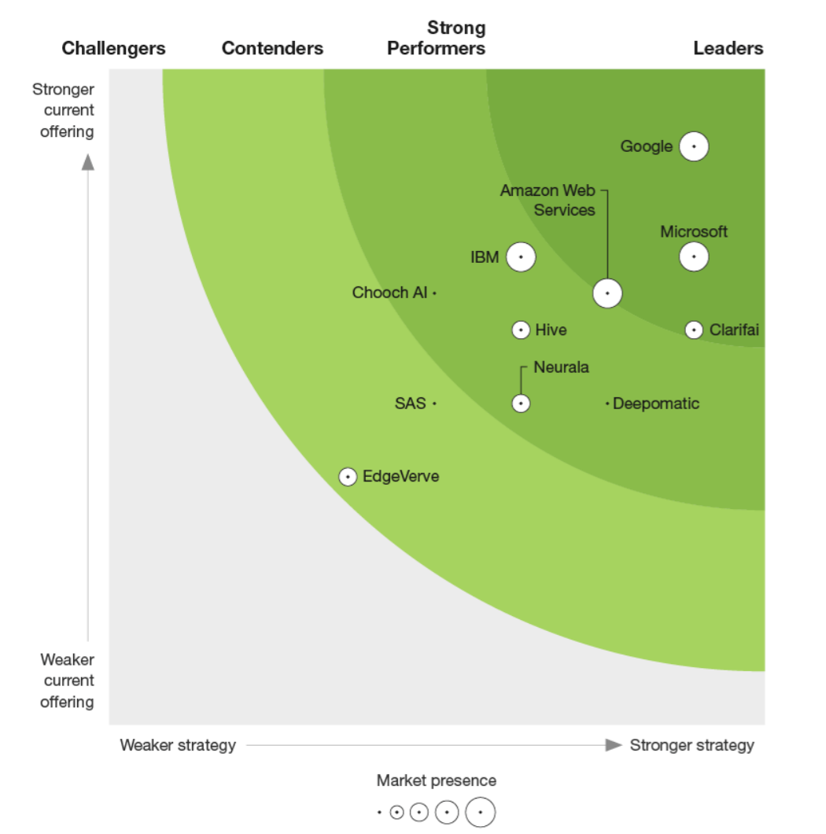
Google is a Leader in The Forrester New Wave™: Computer Vision Platforms, Q4 2019
The Forrester New Wave™ is copyrighted by Forrester Research, Inc. Forrester and Forrester Wave™ are trademarks of Forrester Research, Inc. The Forrester New Wave™ is a graphical representation of Forrester’s call on a market. Forrester does not endorse any vendor, product, or service depicted in the Forrester New Wave™. Information is based on best available resources. Opinions reflect judgment at the time and are subject to change.

